Slide 1
Diabetes Mellitus
Name
Registered pharmacist
November 22, 2013

Slide 2
Overview
Prevalence of diabetes
How diabetes works
How diabetes is treated
Complications of diabetes
How diabetes may be prevented

Slide 3
Background

Slide 4
Diabetes Statistics
Diabetes is the 7th leading cause of death in the US
25.8 million people in the US have diabetes
  7 million people are undiagnosed
  79 million people have prediabetes
Some races have a higher prevalence of diabetes
  Non-Hispanic blacks, Hispanics and Native Americans
Becoming more common in people under 20
  Most common chronic disease of childhood

Slide 5
Types of Diabetes
Type 1 Diabetes
  Usually happens in childhood
  Pancreas doesn’t make insulin
Type 2 Diabetes
  Usually happens later in life
  Body is resistant to insulin
Prediabetes
  Occurs before Type 2 Diabetes
Gestational Diabetes
  Diabetes during pregnancy

Slide 6

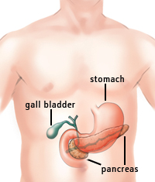

What Normally Happens in Your Body?
Insulin
Sugar
Cell
ENERGY!
Notes:
Insulin is like a key that opens the cell and allows the sugar to enter the cell. This allows the cell to use the sugar to make energy.

Slide 7
What happens in your body if you have diabetes?
Sugar
Sugar
Sugar
Sugar
Insulin
Cell
TOO MUCH SUGAR!!
Sugar
Sugar
Notes:
In Type 2 diabetes it is like the cell has changed the locks and the insulin key no longer works. This means that the sugar cannot get into the cell and therefore it stays in the bloodstream. This leads to high blood sugar. Since the sugar cannot get into the cells, the cells cannot use the sugar to make energy. This means a person who has diabetes has less energy and may feel tired and fatigue.

Slide 8
How much sugar is in the body?
Ways to check blood sugar levels:
  Right now: blood glucose reading
  Long term: Hemoglobin A1C
Every diabetic will have target blood sugars
For non-diabetics goals are usually:
  70 - 100 mg/dL before eating anything
  <140 mg/dL after eating a meal
Notes:
Pre-diabetes FPG 100-126
2-h OGTT 140-199
A1C 5.7-6.4%

Slide 9
Symptoms of Diabetes
Hyperglycemia (High blood sugar)
  Frequent urination
  Excessive thirst
  Irritability
  Increased fatigue
  Dry mouth and skin
  Changes in vision
  Weight loss
  Increased susceptibility to infection – poor wound healing

Slide 10
Symptoms of Diabetes
Hypoglycemia (Low blood sugar)
  Dizziness
  Shakiness
  Sweating
  Hunger
  Pale skin color
  Clumsiness or loss of balance
  Inability to concentrate or anxious
  Unexpected and unexplained changes in mood

Slide 11
Treatment

Slide 12
How is diabetes treated?
The main goal of treatment is to get blood sugars under control
Treatment will vary if a person has Type 1 or Type 2 diabetes
Type 1 diabetics always need insulin
Type 2 diabetics usually take oral medications first but may take injections too

Slide 13
Complications

Slide 14
Complications of Type 2 Diabetes
High blood pressure
Heart disease and stroke
Foot complications
Kidney disease
Eye complications
Nerve damage
Notes:
These are all consequences of both Type 1 and Type 2 diabetes. Most of the complications are related to each other. For example, high blood pressure can lead to heart attacks. These complications are not meant to scare anyone and it also does not mean that people with diabetes will have all of these problems. With good management of diabetes many of these complications can be prevented.

Slide 15
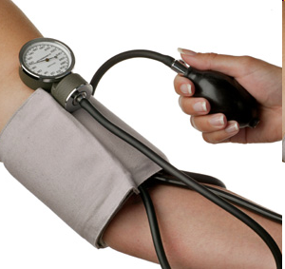
High Blood Pressure
High blood pressure is called hypertension
Consequences of high blood pressure
  Heart must work harder and damage to the heart can occur
  Blood vessels can be damaged due to constant pressure
Notes:
Use hose analogy to explain what high blood pressure is. (Normally, water easily flows through a hose, but when you put a kink in the hose (or step on it), the water builds up, causing a build up of pressure in the hose which could damage it. Similarly, if the pressure in your blood vessels is high, it can cause damage to them.)
Diabetes is the leading cause of end-stage renal disease. Diabetes can make the kidneys filter too much blood which causes them to work too hard, leading to damage. Both high blood sugar and high blood pressure can lead to kidney damage. The kidneys work as a filter to help us get rid of things our body doesn’t need but keep things our body does need.

Slide 16
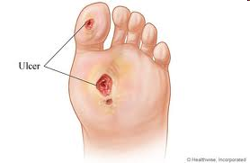
Foot Complications
Diabetes can lessen feeling especially in the feet
  If there is a loss of feeling, an injury may be difficult to notice
Diabetes can also lead to poor blood circulation
  If there is poor blood circulation an injury may heal more slowly
As a result of both of these, people with diabetes can suffer from
  Calluses
  Foot ulcers
  Amputations
Notes:
Burn feet in bath water b/c they can’t feel how hot it is; amputations of feet or leg

Slide 17
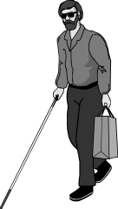
Eye Complications
Glaucoma
  Occurs due to build up of pressure in the eye
  People with diabetes are 40% more likely to develop
Cataracts
  Leads to cloudy vision
  People with diabetes are 60% more likely to develop
Retinopathy
  Occurs due to blood vessel damage in the retina
  The longer someone has diabetes the more likely they are to develop retinopathy
Notes:
Diabetes is the leading cause of new blindness in people 20-74 years old. There are 12,000-24,000 new cases of blindness every year due to diabetes.

Slide 18
Prevention

Slide 19
Why do people get Type 2 Diabetes?
Multiple factors can increase chances of getting Type 2 diabetes
Some factors you can change but others you cannot
Some factors you can work to change include
  Diet
  Amount of physical activity

Slide 20
What are some examples of a healthy diet? An unhealthy diet?

Slide 21


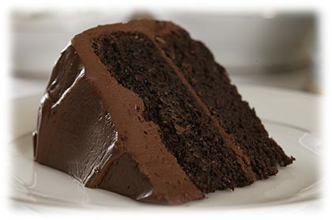
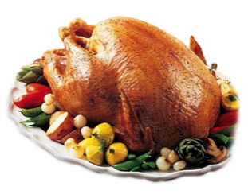







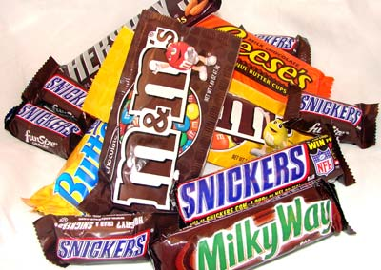


Diet Choices
Healthy Diet:
Unhealthy Diet:

Slide 22
Dietary Recommendations
Saturated fat <7% of total calories
Trans fat intake should be minimized
Carbohydrates = 130 grams per day
Fiber = 14 grams per 1,000 kcal (whole grains)

Slide 23
What are some activities you can do to prevent diabetes?

Slide 24
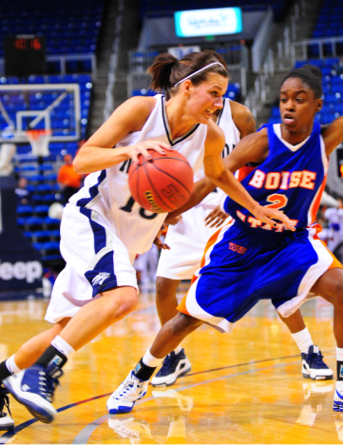
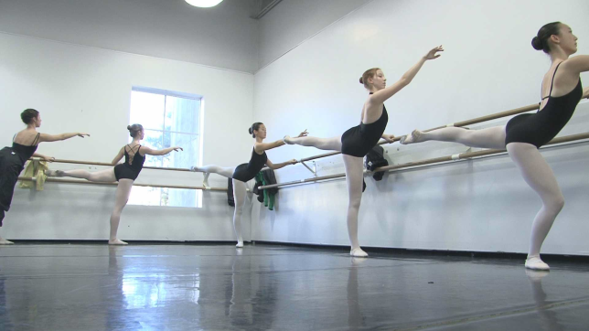
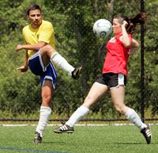
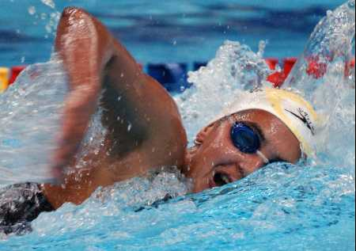
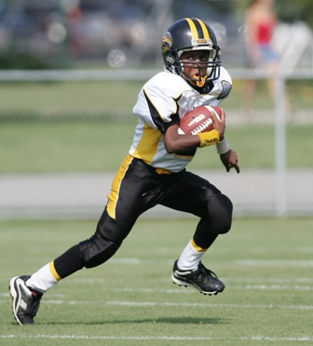

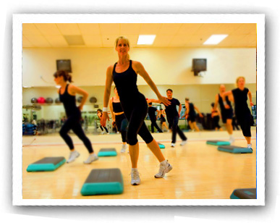


Physical Activity
Notes:
The recommended amount of physical activity for most children and teenagers is 60 minutes a day most days of the week. Of course this can vary if you have other health conditions. (ADA website)

Slide 25

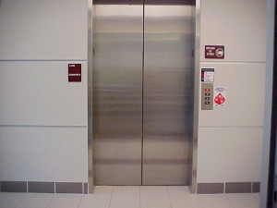
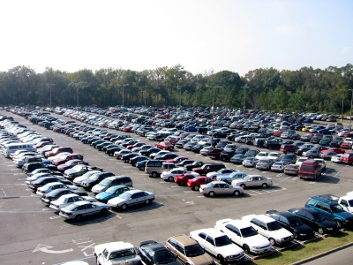
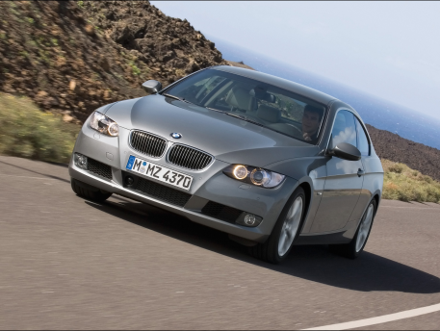
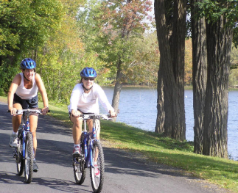

Ways to Increase Physical Activity in Every Day Life
instead of
Use
Park
instead of
Try
or
instead of
Notes:
Other ways to increase physical activity are to do yard work or house cleaning.

Slide 26
Exercise Recommendations
150 minutes per week of moderate-intensity
  Walking
  Biking
  Yoga
75 minutes per week vigorous aerobic activity
  Running
  Jumping rope
  Swimming laps
Notes:
This is an OR situation
Resistance training three times a week is also recommended if able for older patients

Slide 27
Other Ways To Stay Healthy
Diabetics are at higher risk for some diseases, and should be vaccinated
  Flu shot every year
  Tdap (tetanus and whooping cough)
  Pneumococcal (pneumonia)
  Hepatitis B
  Zoster (shingles)
Even if you don’t have diabetes the flu shot can help you stay healthy
Pharmacists are an excellent resource!

Slide 28
Questions?

Slide 29
Diabetes Mellitus
Name
Registered pharmacist
November 22, 2013

