Slide 1
PHARMACISTS MUTUAL INSURANCE COMPANY

Slide 2
Who We Are
Pharmacists Mutual Insurance Company is a nationally recognized leader providing insurance and risk management solutions for independent pharmacy owners since 1909. Pharmacists Mutual employs over 300 professionals through its operations in all 50 states, the District of Columbia, and Puerto Rico. The company offers professional liability, commercial, and personal insurance products.

Slide 3
Who We Are continued…
Financially secure, Pharmacists Mutual is an A.M. Best "A" Excellent* rated property and casualty insurance provider. We take pride in being your single source for insurance protection. Our broad portfolio of products and services provides for our members’ professional, personal, and business insurance needs.
Learn more about Pharmacists Mutual and our full product line at phmic.com.
*A.M. Best Financial strength rating is an independent opinion.

Slide 4
Kurt Dickinson
330.696.3398 kurt.dickinson@phmic.com

Slide 5
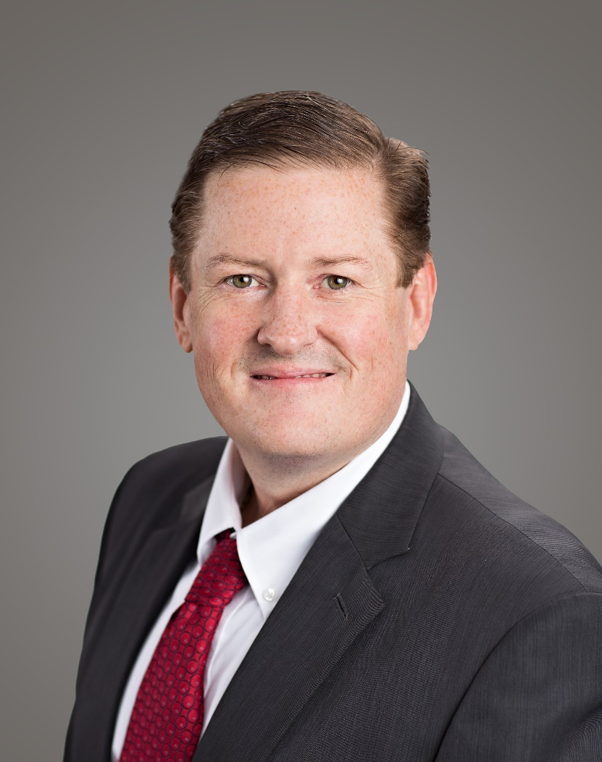
Brian Ormond
740.507.2542 brian.ormond@phmic.com

Slide 6
VISTA – Business Package Policy
Commercial Liability
Cyber Liability
Sexual Misconduct and Physical Abuse
Employment Practices Liability
Pharmacy Professional Liability
Commercial Property
Coverage Enhancements
VIEW
Protection Plus
Protection Elite
Policy terms and conditions control. Coverage may not be available in all states.

Slide 7
Additional Coverage Options
Individual Pharmacist Professional Liability
Workers’ Compensation
Commercial Auto
Commercial Umbrella
Personal Lines* - Home, Auto, Personal Umbrella, Boat
Policy terms and conditions control. *Coverage may not be available in all states.

Slide 8
Products Offered through PMC Advantage
Executive Liability
Surety and Fidelity Bonds
Life
Business - Buy-Sell Agreements, Key Person Insurance, Deferred Compensation Benefits
Personal – Whole Life, Term Life, Universal Life
Disability
Coverage may not be available in all states. PMC Advantage Insurances Services., Inc., is a wholly owned subsidiary of Pharmacists Mutual Insurance Company.

Slide 9
Member Portal App
App Available
Report a Claim
Update Your Information
Add Additional Authorized Portal Users
View Your Agent Contact Info
Pay Your Bill
Go Paperless*
Auto Pay
View and Download Your Policy Documents
Access the Risk Management Center**
*Paperless delivery not available in the state of Ohio. **Risk Management Center only available for commercial members.

Slide 10
Our Members – Market Segments
Pharmacy
Dental
Grocery
Home Health Care
Home Medical Equipment
Personal Care Provider
Life Sciences
Veterinary
Card and Gift

Slide 11
Pharmacists Mutual Insurance Company 808 Highway 18 W | PO Box 370 Algona, Iowa 50511 P. 800.247.5930 | F. 515.295.9306 info@phmic.com
phmic.com

